Slide 1

Catching Fire
Screen Shots
Flight Dates: 10/1 – 11/13

Slide 2
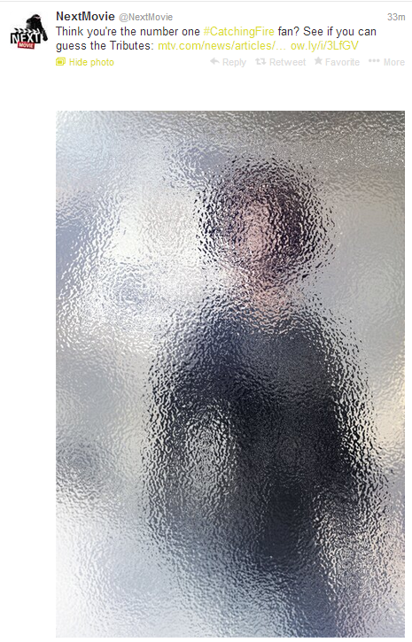
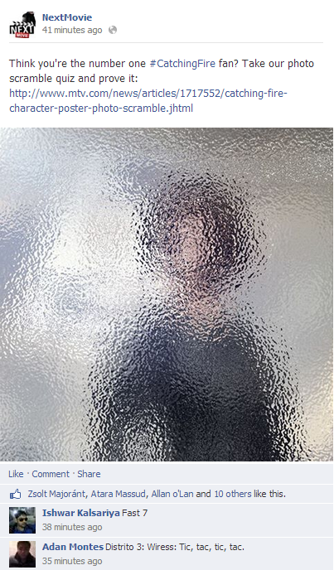
Catching Fire Next Movie social
https://twitter.com/NextMovie/status/402497375979470848
https://www.facebook.com/photo.php?fbid=695203020492372&set=a.157410364271643.31071.121080177904662&type=1

Slide 3
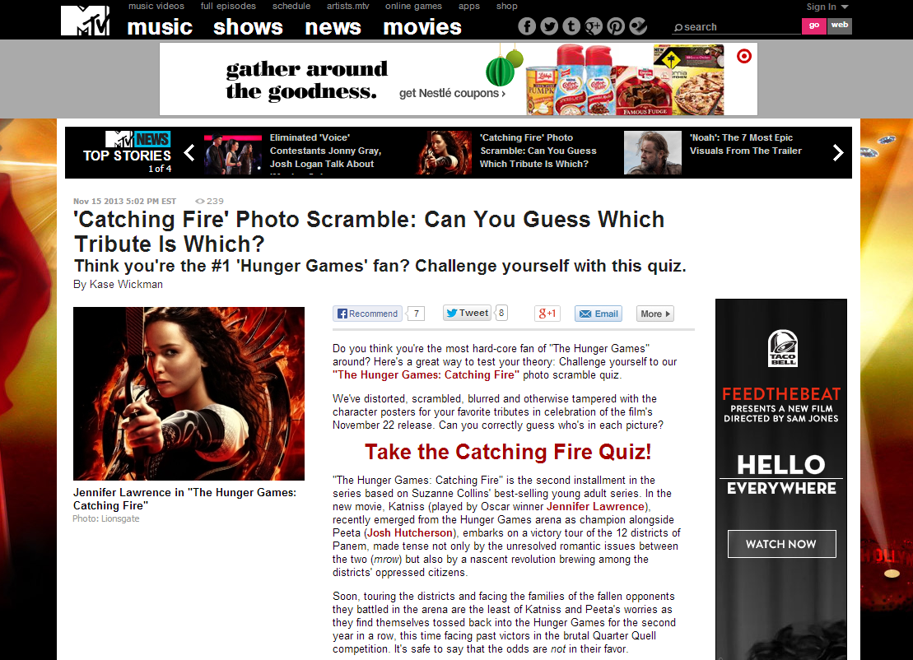
Catching fire mtv editorial

Slide 4
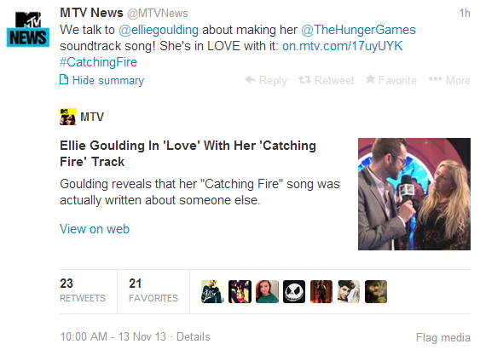
Catching Fire Social

Slide 5
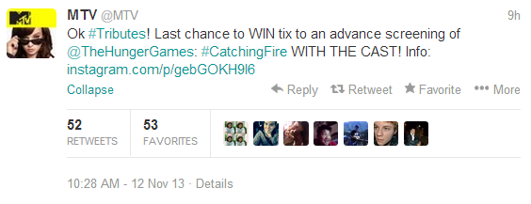
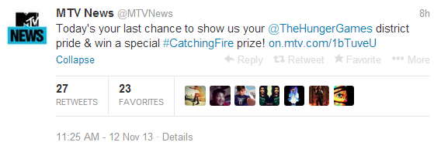
Catching Fire Social

Slide 6
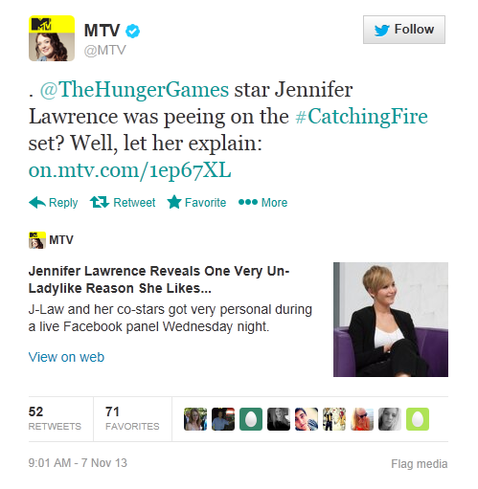
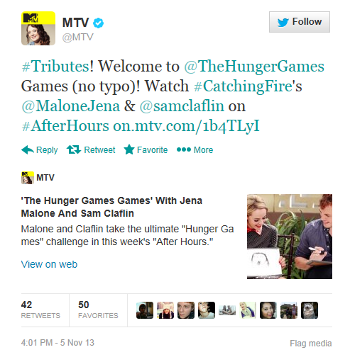
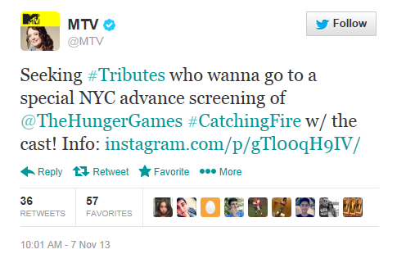
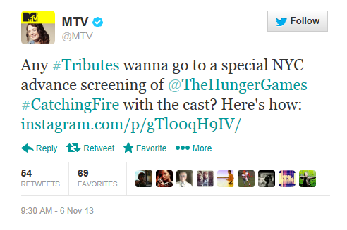
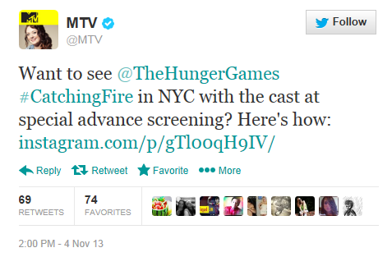
Catching Fire Promotional tweets
Notes:
https://twitter.com/MTV/status/398495531745681409
https://twitter.com/MTV/status/398140324620800000
https://twitter.com/MTV/status/398510508665741313
https://twitter.com/MTV/status/397876323894718464
https://twitter.com/MTV/status/397483433020391424

Slide 7
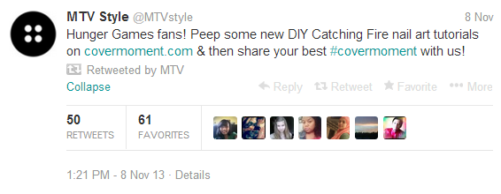
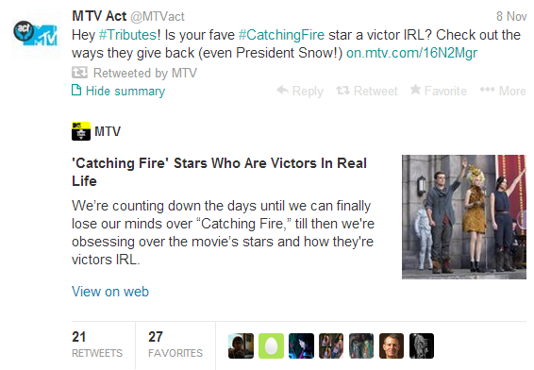
Catching Fire Beginners Guide Editorial

Slide 8
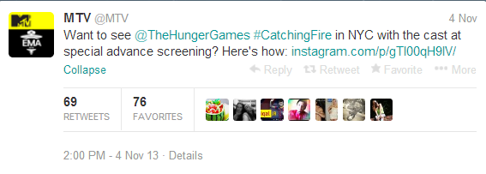
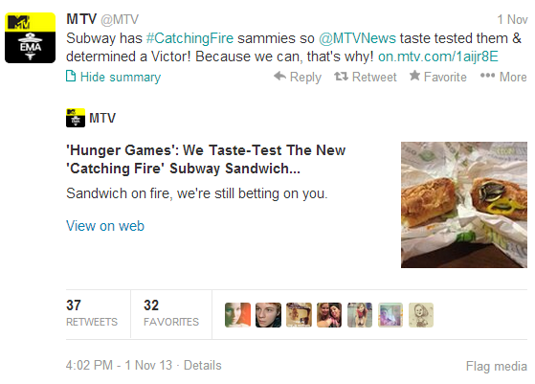
Catching Fire 11/4 Social Posts

Slide 9
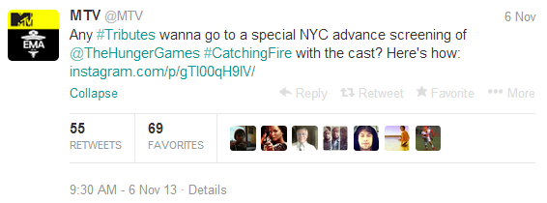
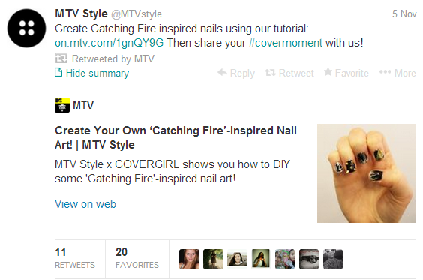
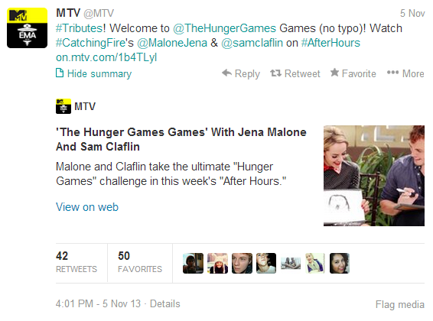
Catching Fire 11/6 - 11/5 Social Posts

Slide 10
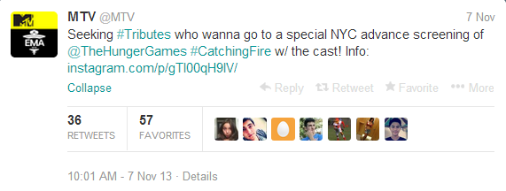
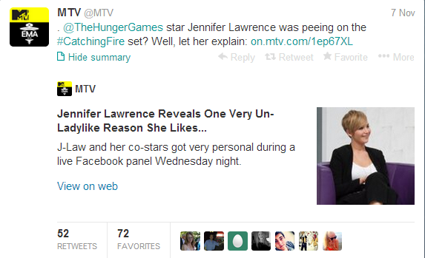
Catching Fire 11/7 Social Posts

Slide 11
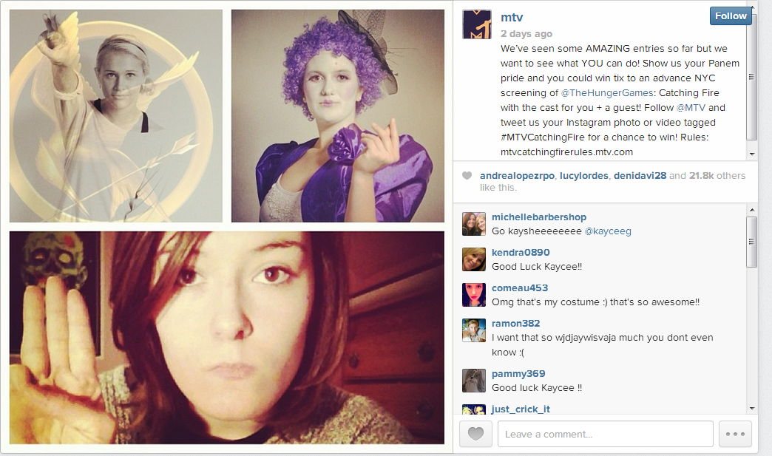
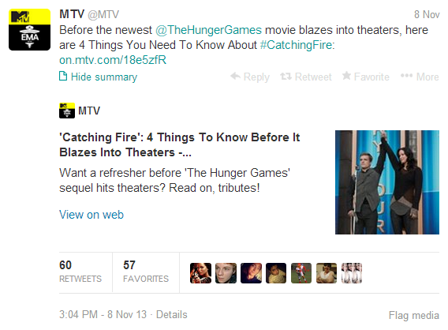
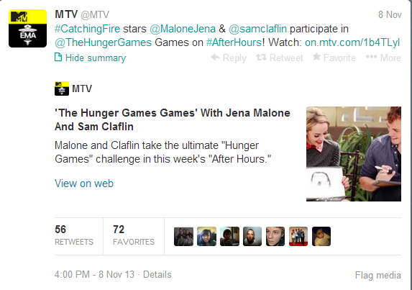
Catching Fire 11/8 Social Posts

Slide 12
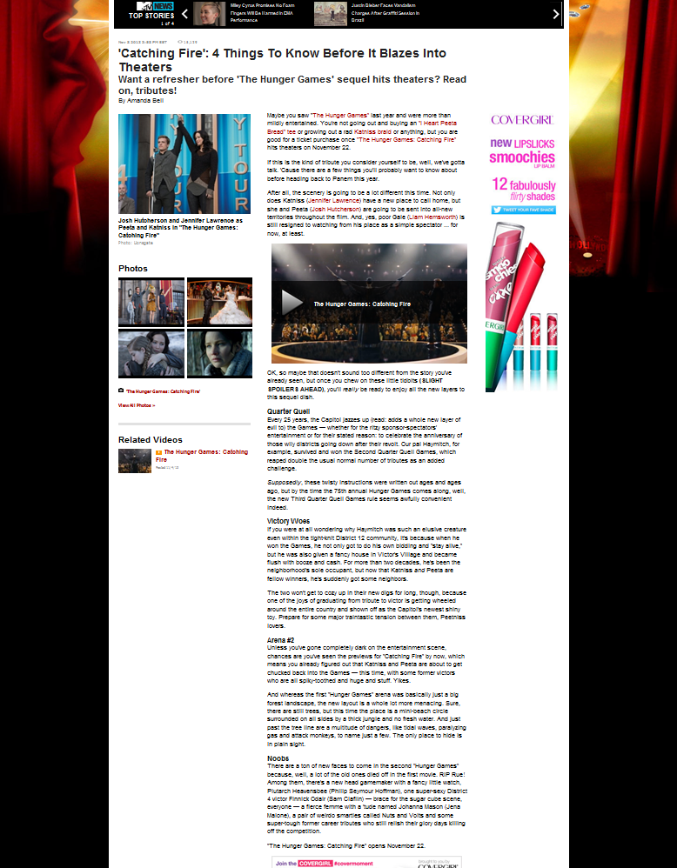
Catching Fire Beginners Guide Editorial

Slide 13
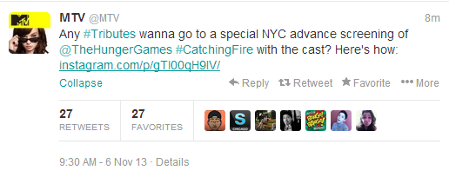
Social Posts 11/6
https://twitter.com/MTV/status/398140324620800000

Slide 14
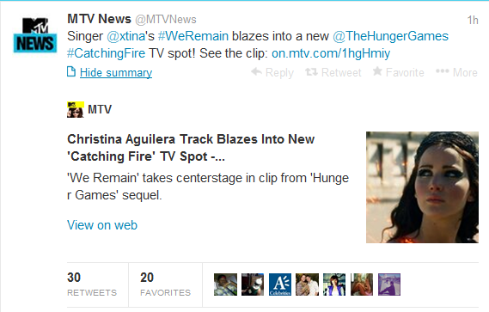
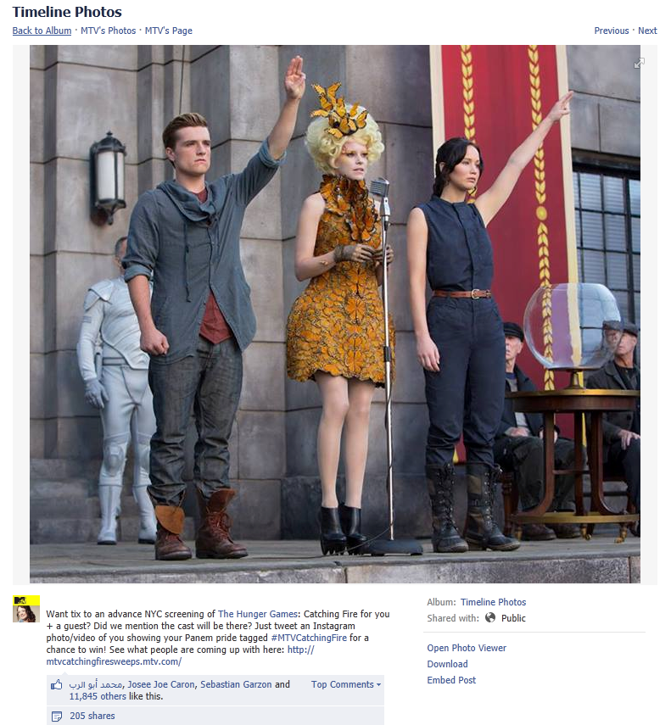
Social Posts 11/5
https://twitter.com/MTVNews/status/397796847261323264
https://www.facebook.com/MTV#!/photo.php?fbid=10151691773866701&set=a.75020081700.87864.7245371700&type=1

Slide 15
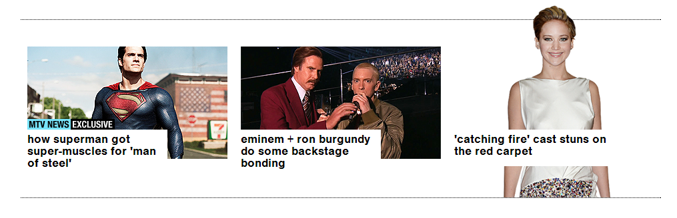
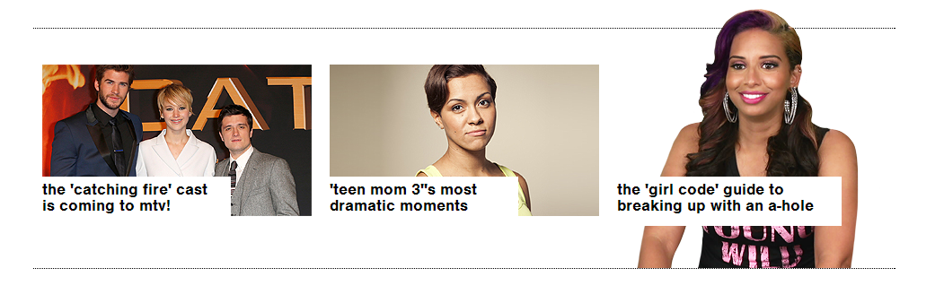
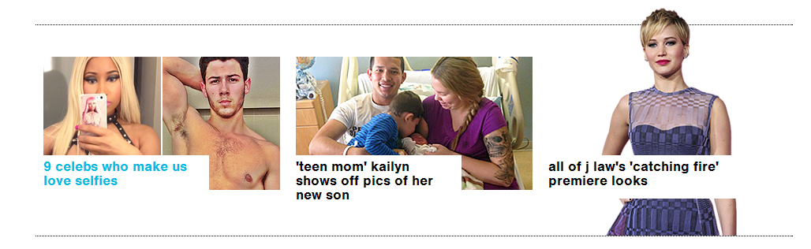
Catching Fire Promo Touts and Promotion

Slide 16
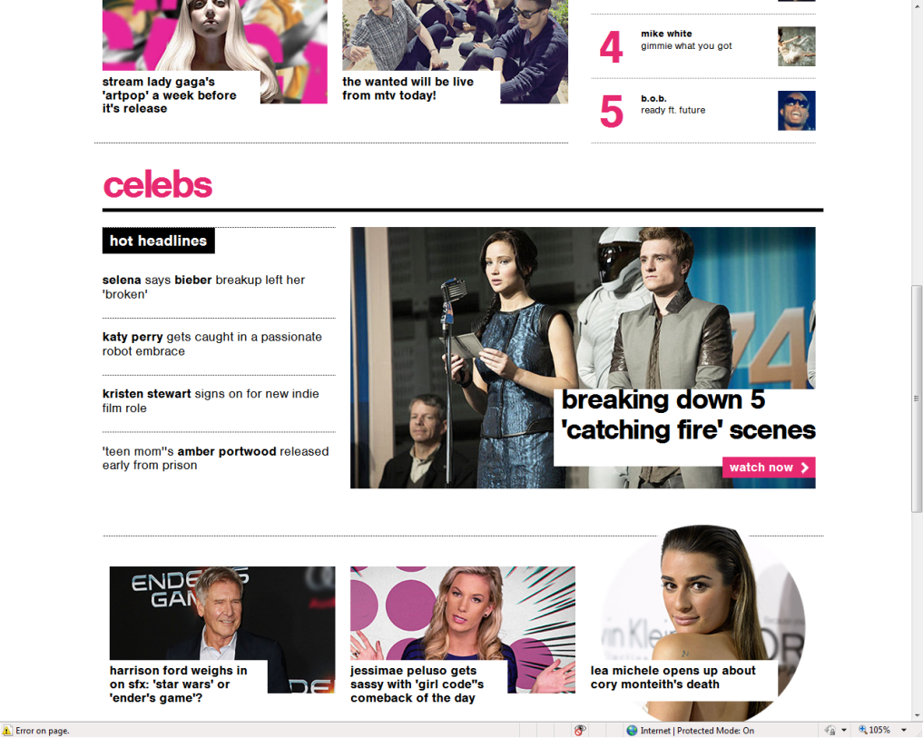
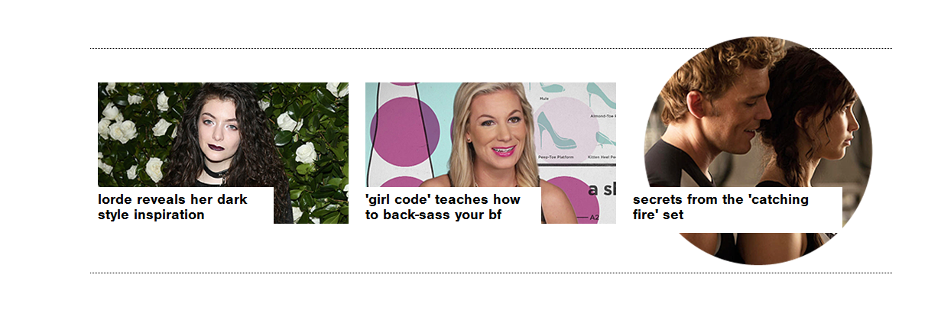
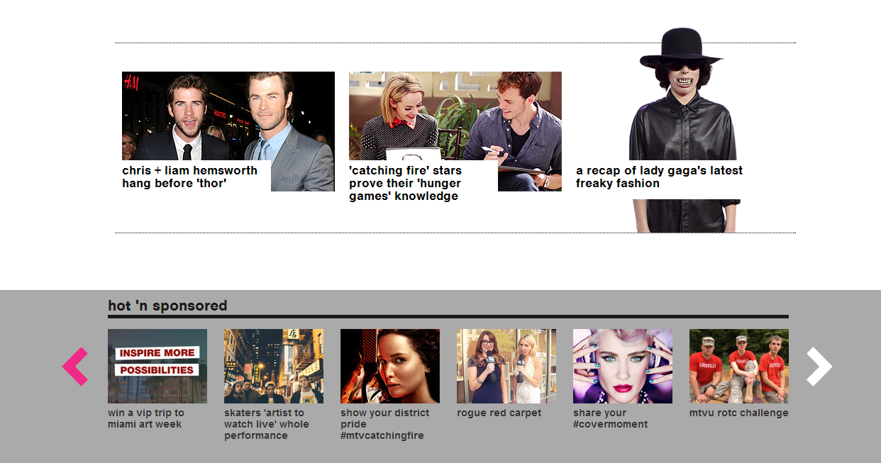
Catching Fire Promo Touts and Promotion

Slide 17
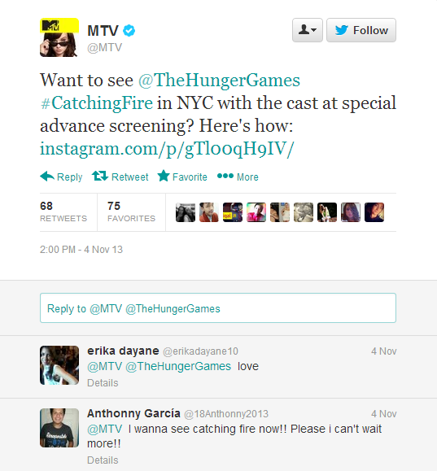
Social Posts 11/4
https://twitter.com/MTV/status/397483433020391424

Slide 18
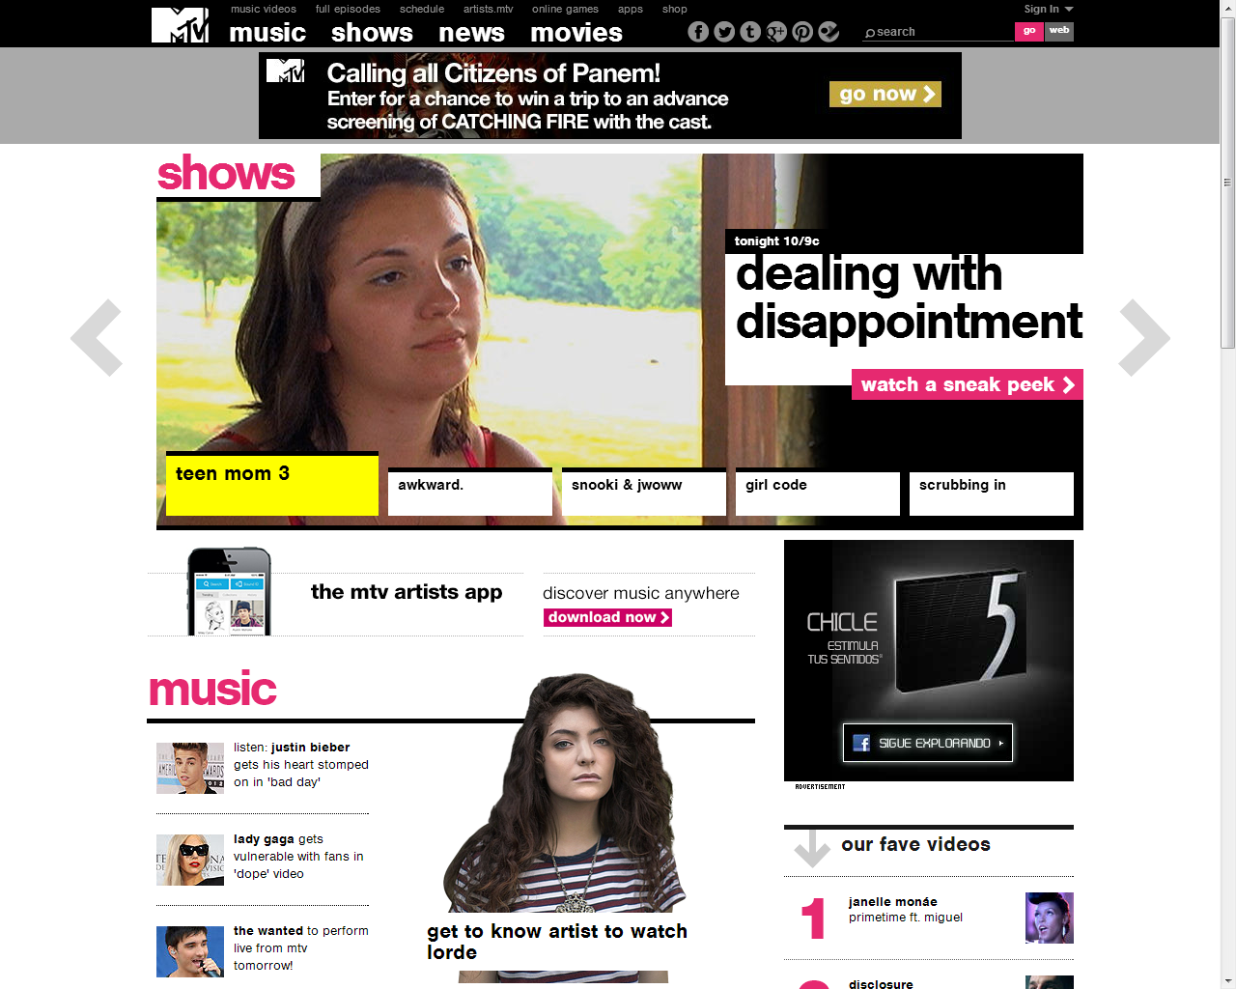
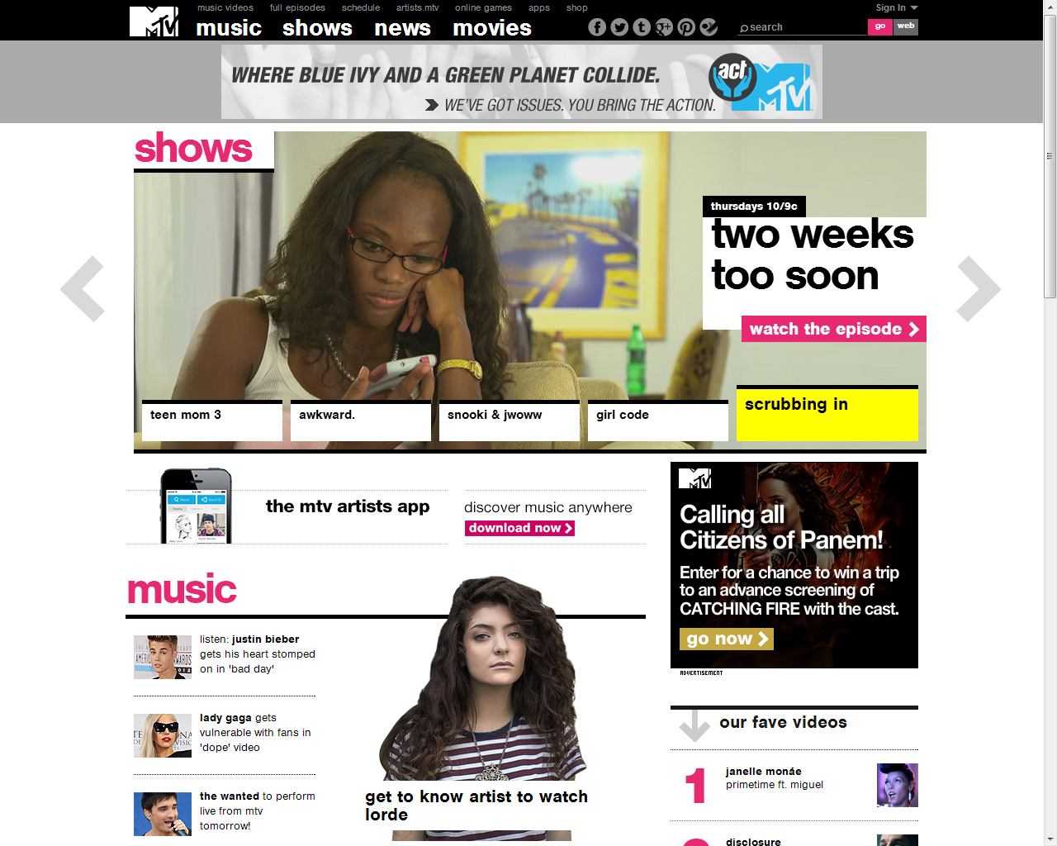
Cobranded Leaderboard and Rectangle

Slide 19
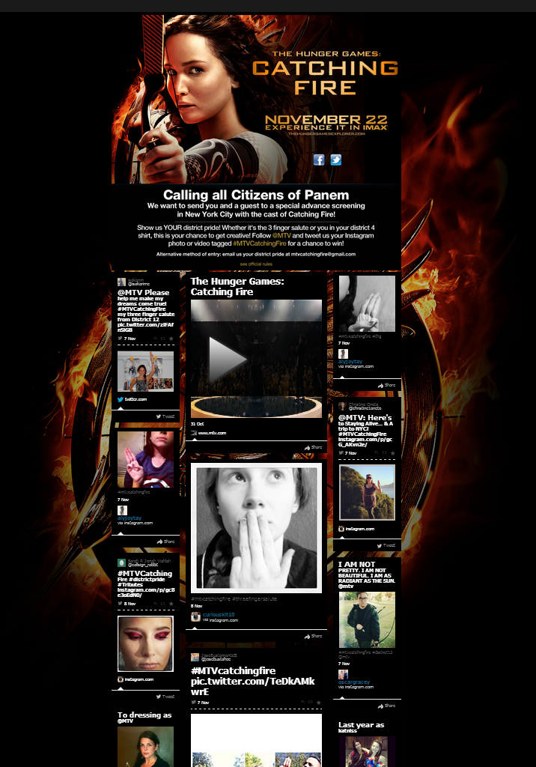
Catching Fire Social Submissions Wall 11/10

Slide 20
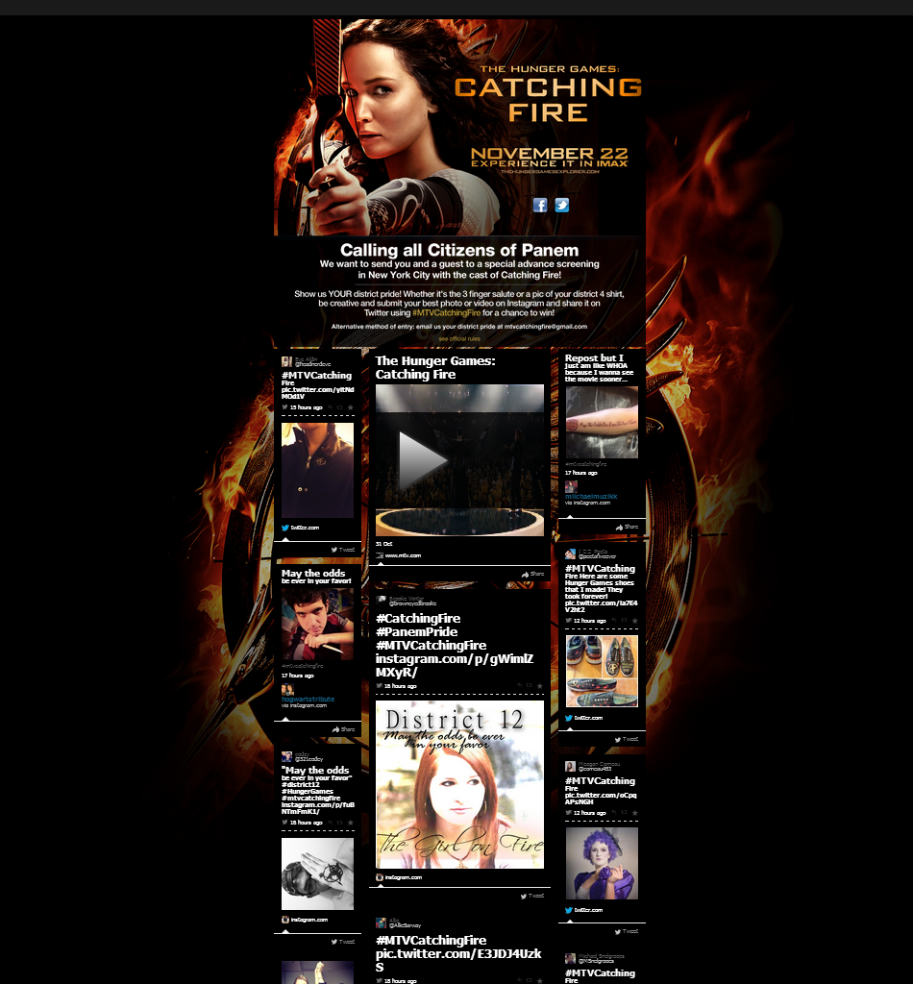
Catching Fire Social Submissions Wall 11/6

Slide 21
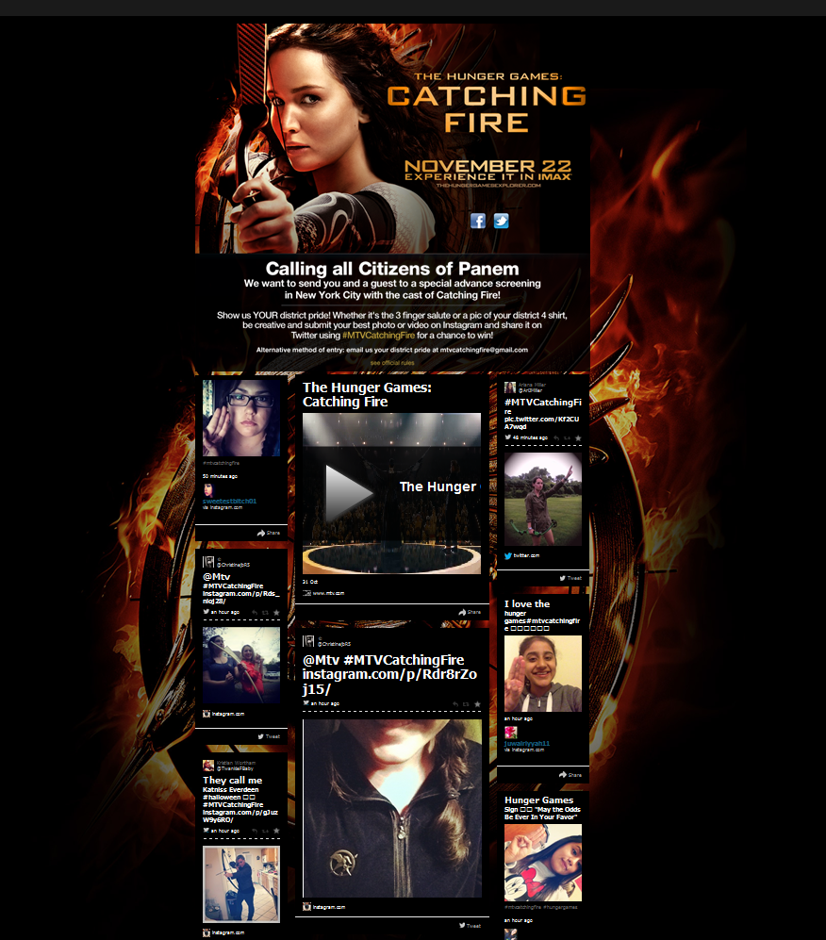
Catching Fire Social Submissions Wall

Slide 22
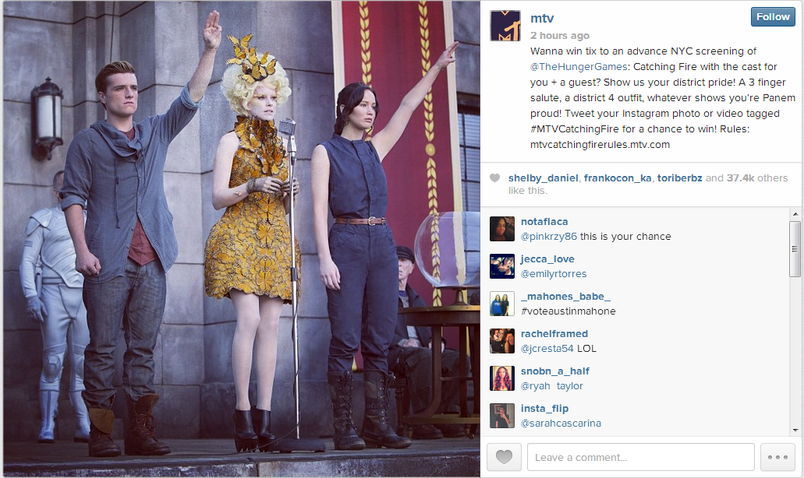
Instagram social post 1x 3 finger slaute - http://instagram.com/p/gTl00qH9IV/

Slide 23
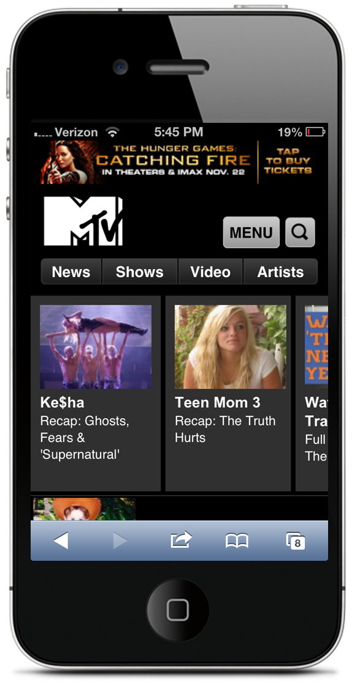
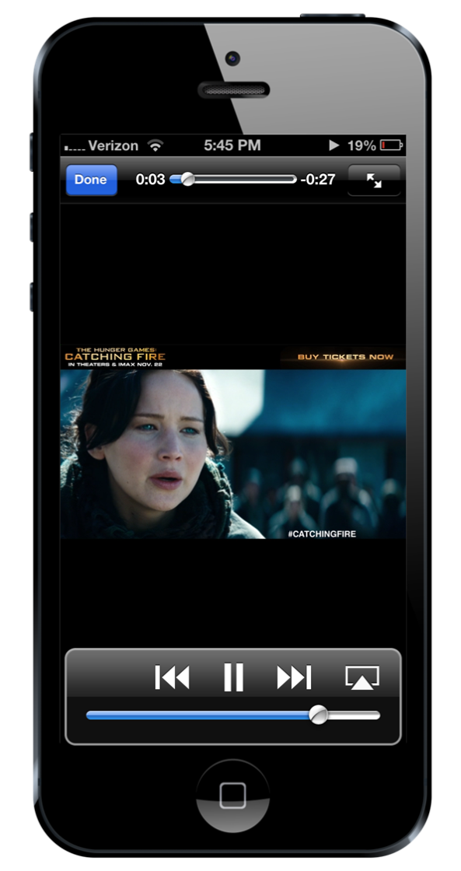
MTV Mobile Click to video

Slide 24


MTV Tablet Leaderboard Click to video

Slide 25
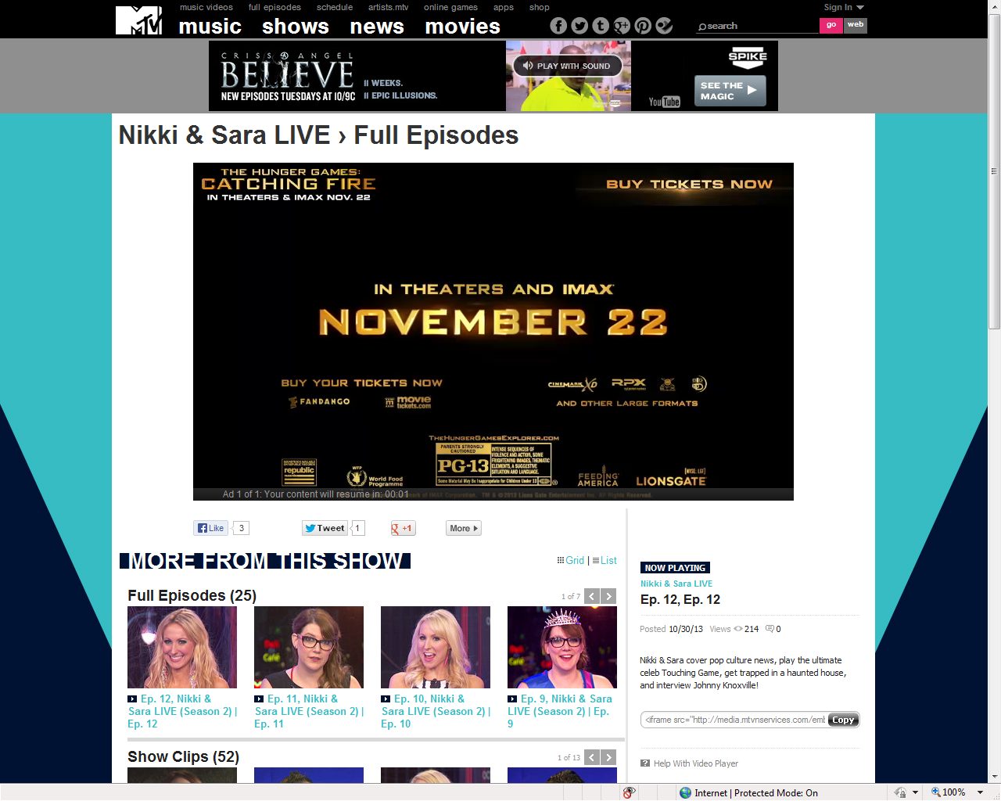
MTV – Video RB - 10/28

Slide 26
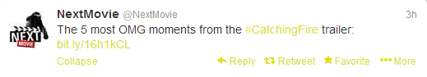
SOCIAL POSTS- NextMovie TWITTER 10/28

Slide 27
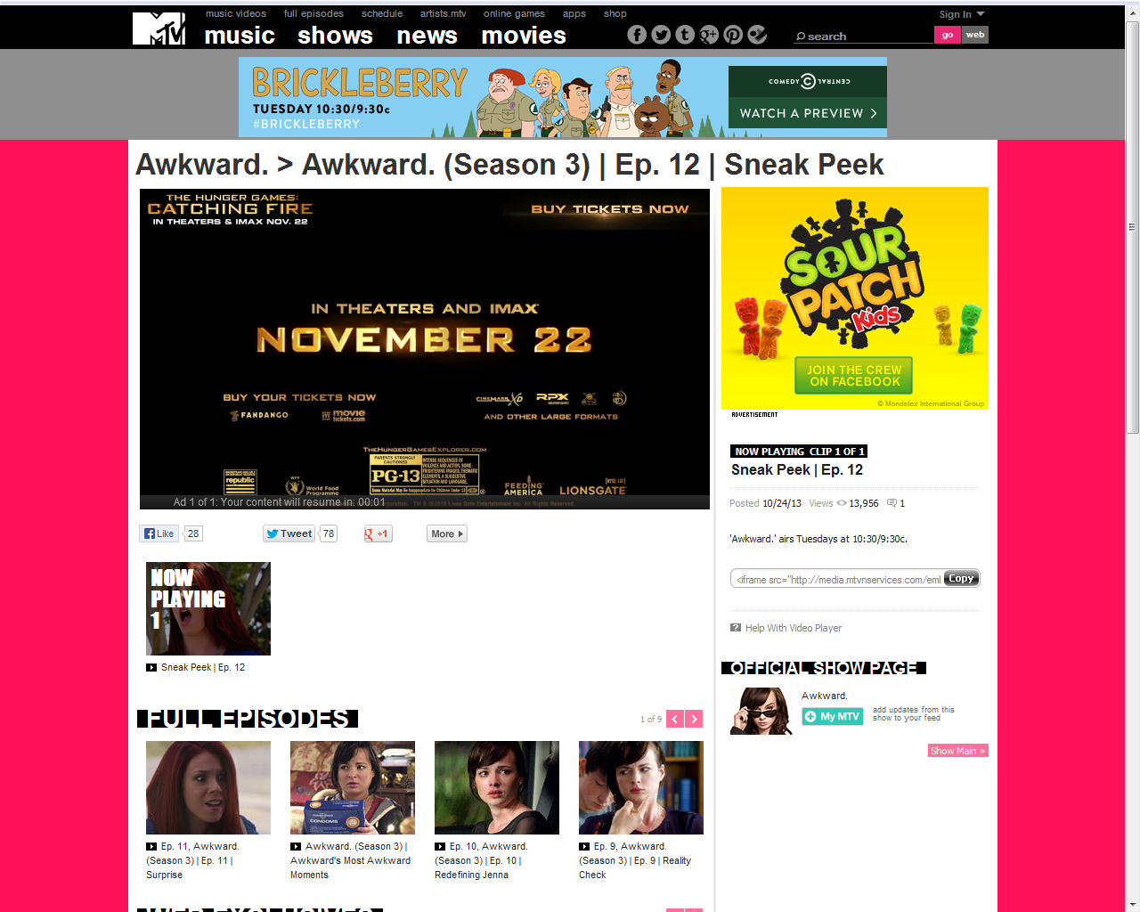
Video Targeted to In Season Programming- including Awkward, Teen Mom & Nikki & Sara Live & Next Movie (640x480)

Slide 28
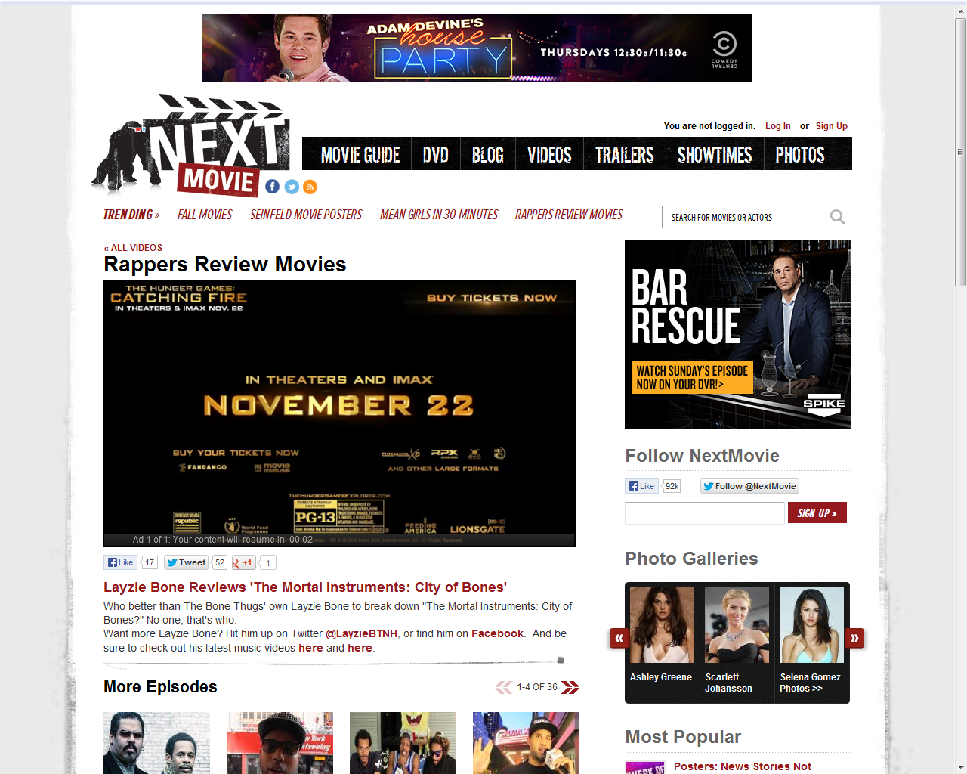
Video Targeted to Next Movie (640x480)

Slide 29
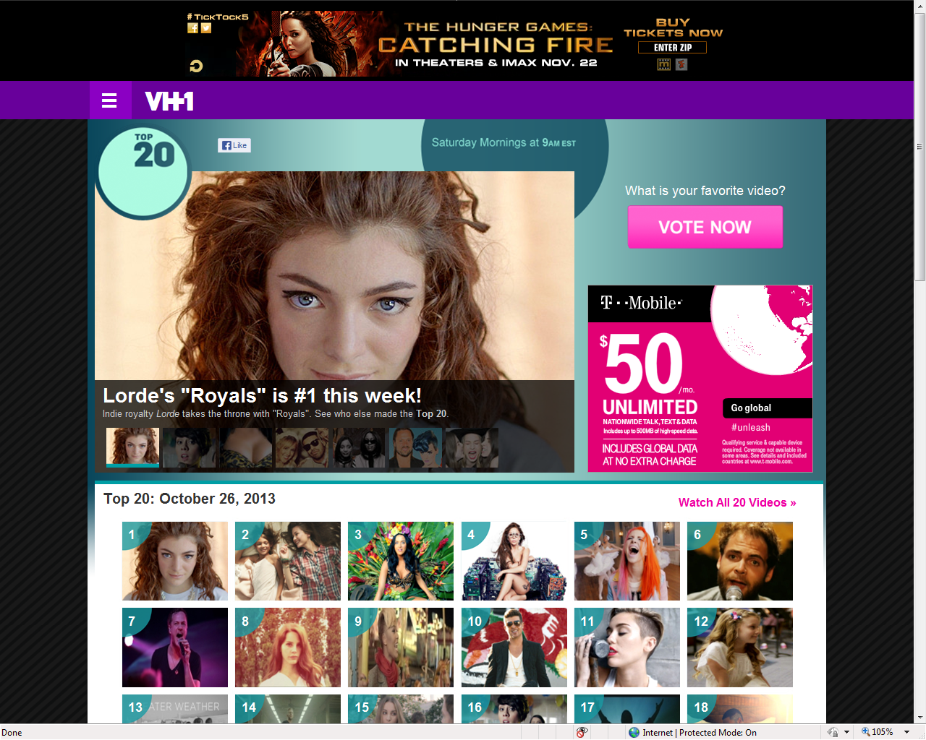
Leaderboard Targeted to MTV, CMT, Vh1

Slide 30

MTV Newsletter-1x 10/28/13

Slide 31
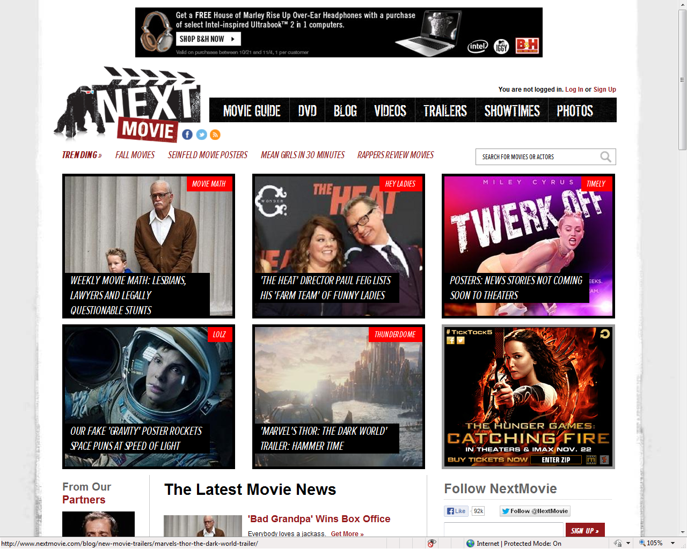
Rectangle Targeted to NextMovie

Slide 32
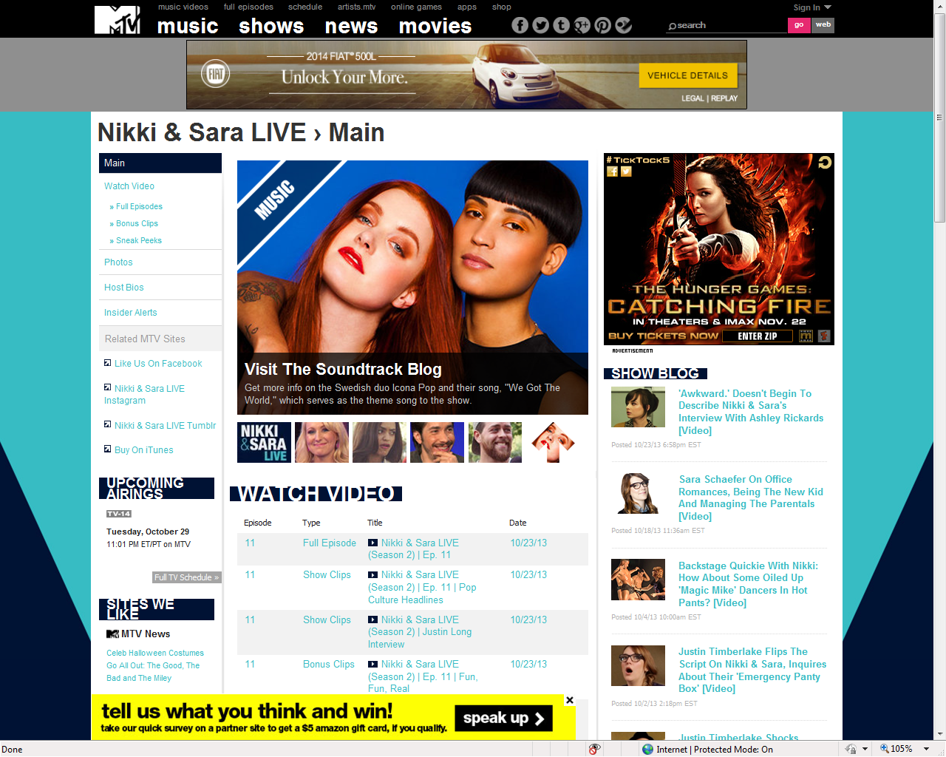
Rectangle Targeted to In Season Programming- including Awkward, Teen Mom & Nikki & Sara Live & NextMovie

Slide 33
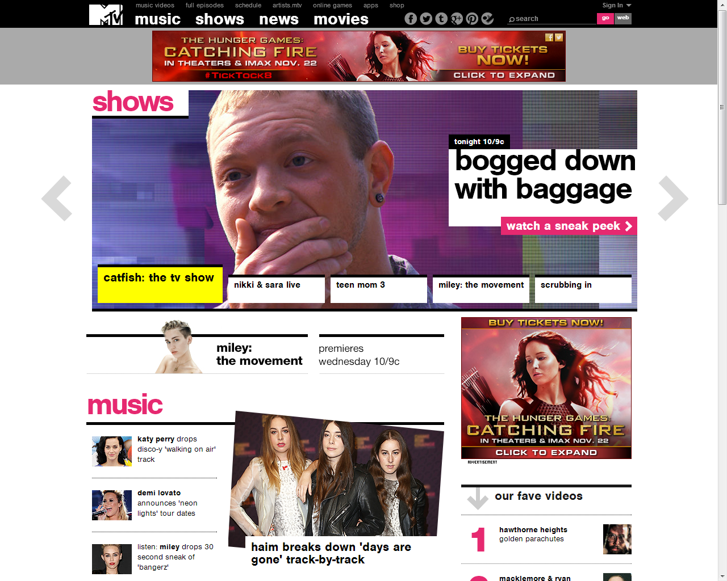
MTV – HOMEPAGE 10/1 RB

Slide 34


CATCHING FIRE- MTV MOBILE HOMEPAGE ROADBLOCK 10/1

Slide 35

CATCHING FIRE- MTV MOBILE HOMEPAGE ROADBLOCK 10/1

Slide 36


SOCIAL POSTS- MTV TWITTER 10/22
Notes:
https://twitter.com/MTV/status/392668067710636032

Slide 37


SOCIAL POSTS- Movies. MTV
Notes:
https://www.facebook.com/movies.mtv#!/photo.php?fbid=218056371697716&set=a.166320160204671.1073741829.165270260309661&type=1
https://www.facebook.com/movies.mtv#!/photo.php?fbid=211698895666797&set=a.166320160204671.1073741829.165270260309661&type=1

Slide 38

SOCIAL POSTS- MTV News
Notes:
https://www.facebook.com/mtvnews#!/photo.php?fbid=618386764870178&set=a.362063643835826.76673.105317422843784&type=1

Slide 39


MTV Movies
Notes:
http://www.mtv.com/photos/the-hunger-games-catching-fire/1700153/8541740/photo.jhtml#8541740

Slide 40



Hunger Game Social Promotions- MTV Twitter, MTV News Twitter, MTV Facebook- 11/6
Notes:
https://twitter.com/MTV/status/398140324620800000
https://twitter.com/MTVNews/status/398088494406717440
https://www.facebook.com/photo.php?fbid=10151695400101701&set=a.75020081700.87864.7245371700&type=1

